Slide 1

The Dark Sector of the Universe and the BINGO/ABDUS project.
I present the observational and theoretical developments concerning the cosmological structure since the Discovery of a Dark Sector comprising the overwhelming majority of cosmological matter constituents.
I especially argue in favour of the construction of the BINGO (BAO from Integrated Gas Observations) observatory, which is being supported by a consortium led by Brazil and China and its second phase, with high resolution, the ABDUS Project, Advanced Bingo Dark Universe Studies.
Elcio Abdalla
2024

Slide 2
Team
Management: Elcio Abdalla, A. Queiroz, Bin Wang, F. Abdalla and others
Builders: JiaJun Zhang, Chang Feng, Ricardo Landim, Alessandro Marins, João Rafael, Edmar Gurjão
Members (USP): Jordany Vieira de Melo, Pablo Motta, Gabriel Hoerning, Eveling Costa and others.
Other members: UFCG, INPE and others (Brazil), China (many Universities and companies), France, UK, Italy.
Total: more than 80 members

Slide 3
Open Problems in the study of the cosmos
What is Dark Energy
What is Dark Matter
Gravity in Cosmology
Fast Radio Bursts
Pulsars

Slide 4
The Dark Matter Question: brief history

Slide 5
The Dark Matter Question: establishing facts

Slide 6
The Dark Matter Question: conclusion

Slide 7
The Dark Energy Question

Slide 8
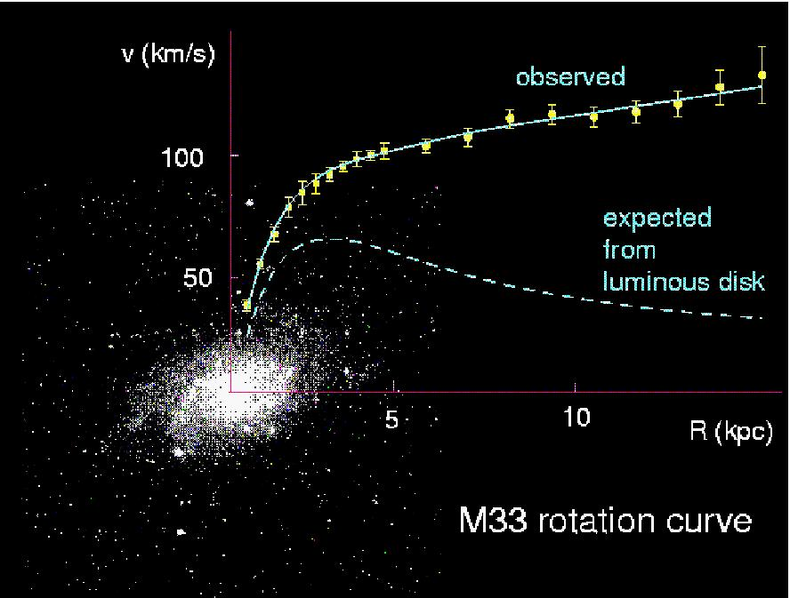
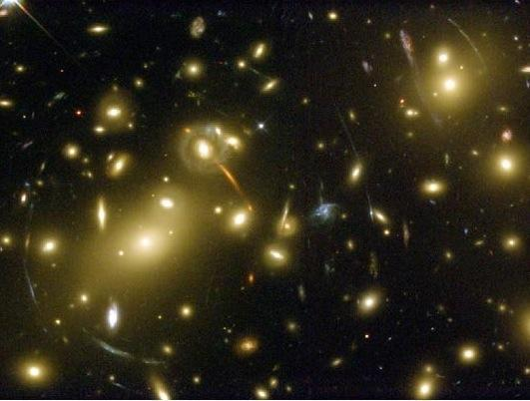
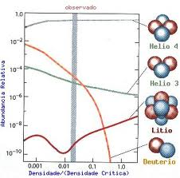
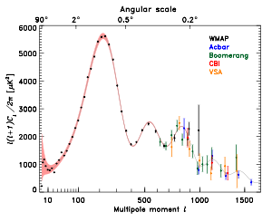
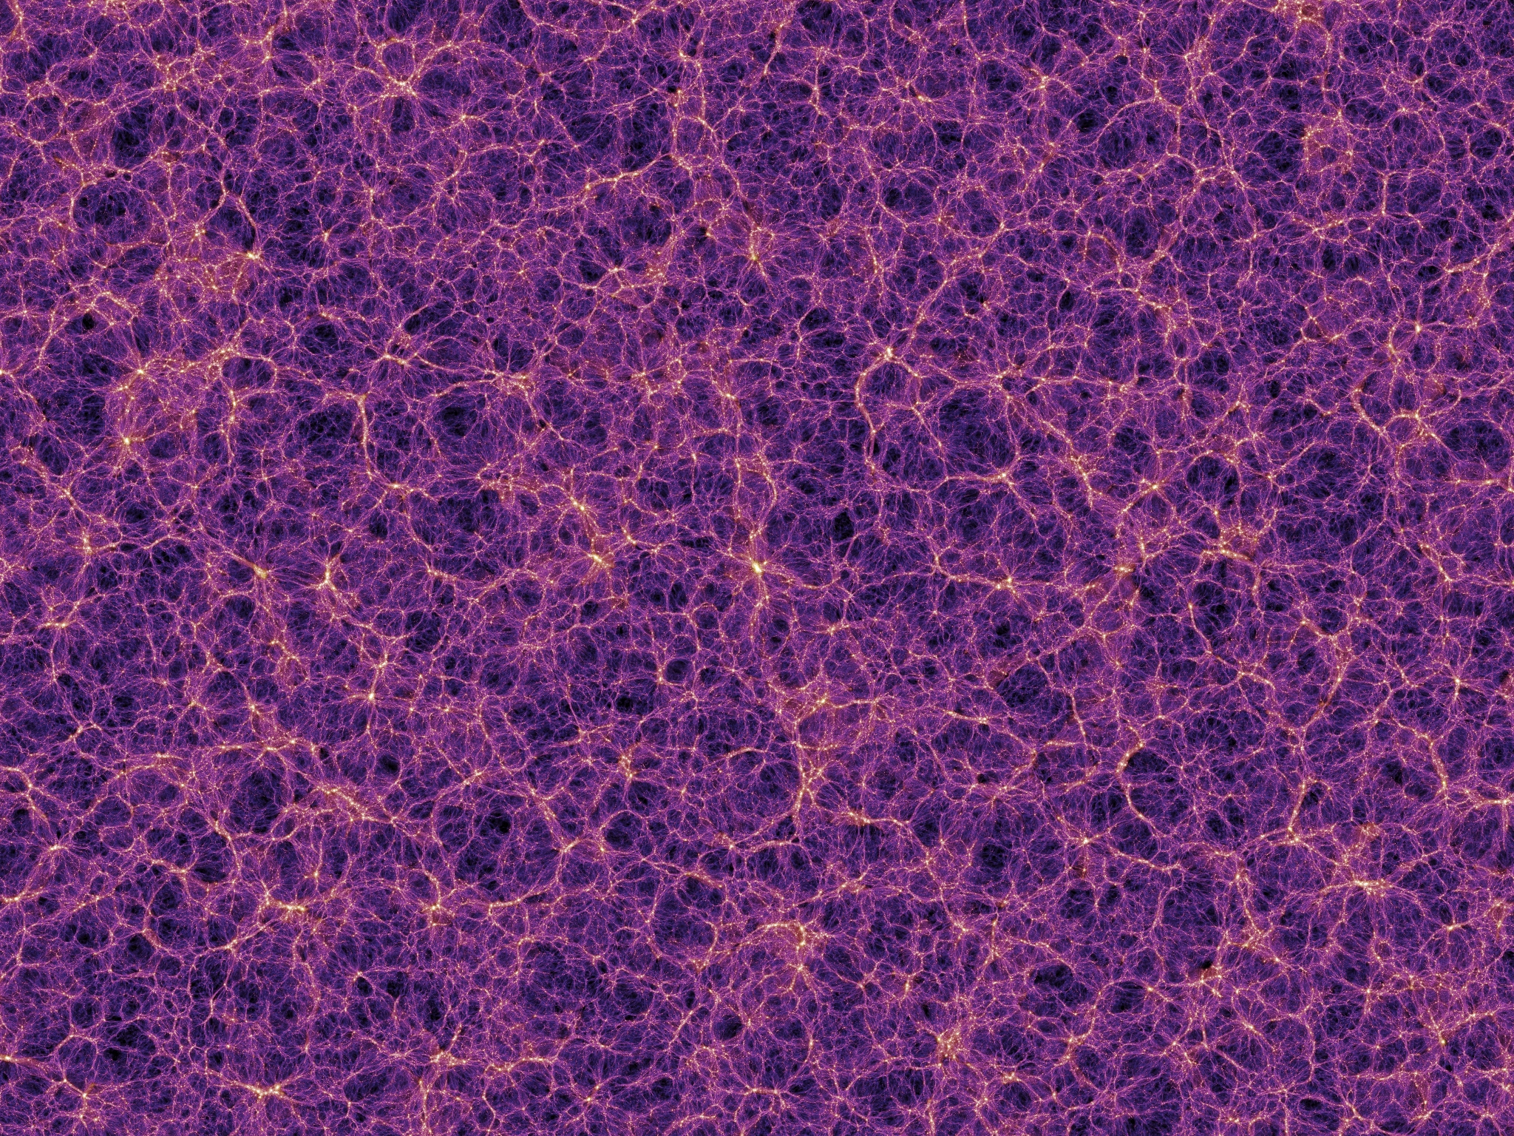
What is Dark Matter?
Evidences for Dark Matter
Huge amount of evidences
indicating that dark matter
exists. One of the biggest
unsolved, but very well measured,
problems in physics.
Observations indicate that DM
interacts mainly gravitationally.
So far, we have no
(non-contradictory) observations
that DM was detected by any
non-gravitational mechanism.
Elcio Abdalla-Interacting Dark Energy

Slide 9
Candidates
Neutralinos (higgsino, bins, winos, singlinos)
Axinos
Gravitinos
Sneutrinos
Axions
Sterile neutrinos
4th generation neutrinos
Kaluza-Klein photons
Kaluza-Klein gravitons
Brane world dark matter/D-matter
Little higgs dark matter
Light scalars
Superheavy states (ie. “WIMPzillas”)
Self-interacting dark matter
Super-WIMPs
Asymmetric dark matter
Q-balls (and other topological states)
CHAMPs (charged massive particles)
Cryptons, …
Supersymetric

Slide 10
The Flatness problem and a Dark Sector

Slide 11
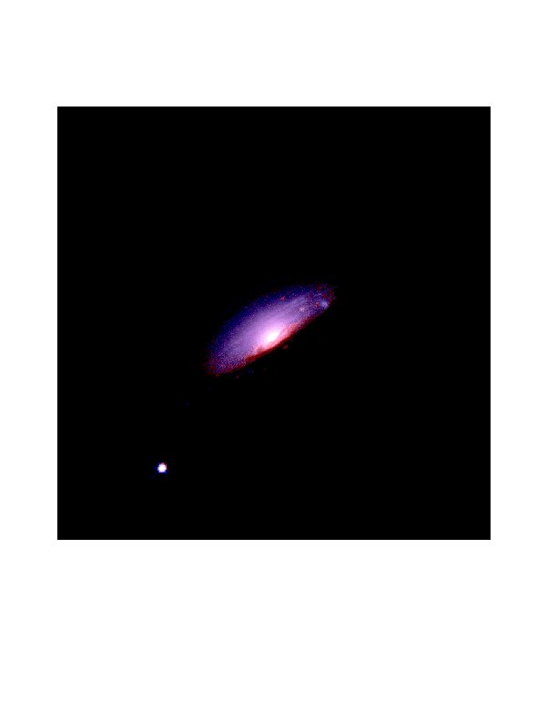
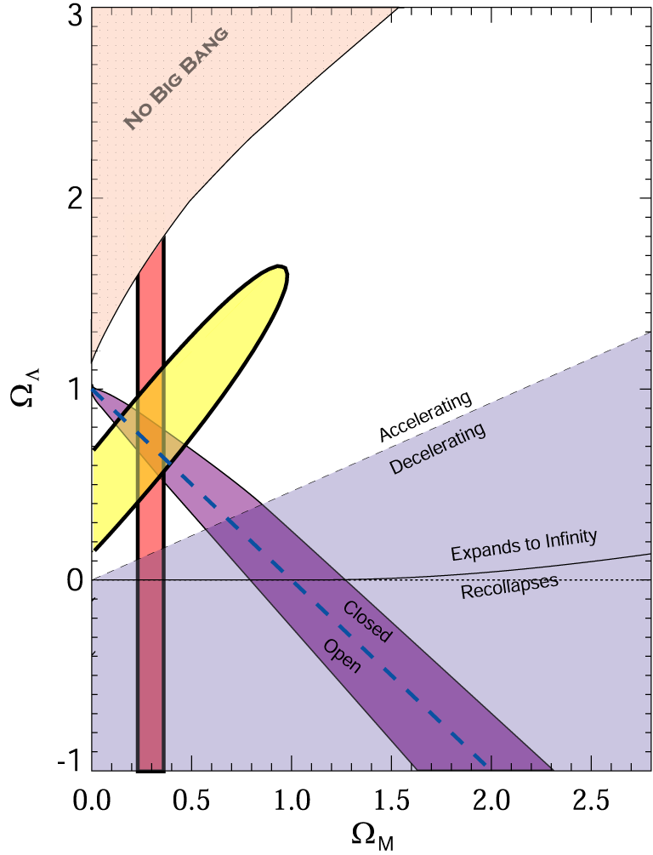
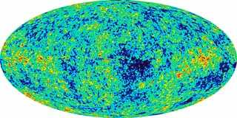
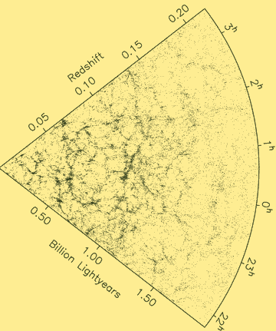
What is Dark Energy?
The Evidence:
98's: The universe is expanding in an accelerated way.
CMB
SNe Ia
Ω_{DE}=0.721±0.025 (WMAP)
WMAP
LSS
Ω_{DE}=0.685±0.013 (Planck)
Source: S. Tsujikawa, “Dark Energy and Modified Gravity"

Slide 12
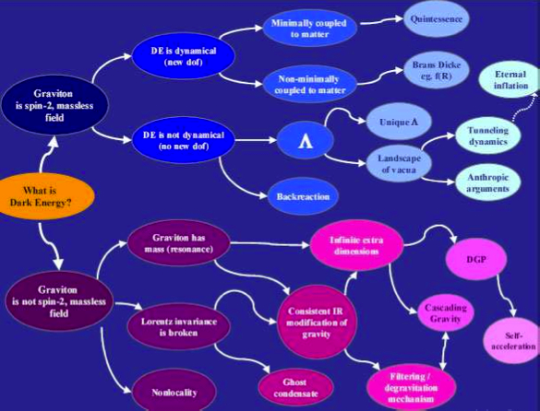
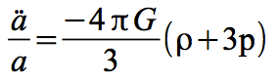
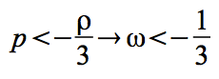
What is causing the acceleration?
Source: de Rahm & Tolley, 2008

Slide 13
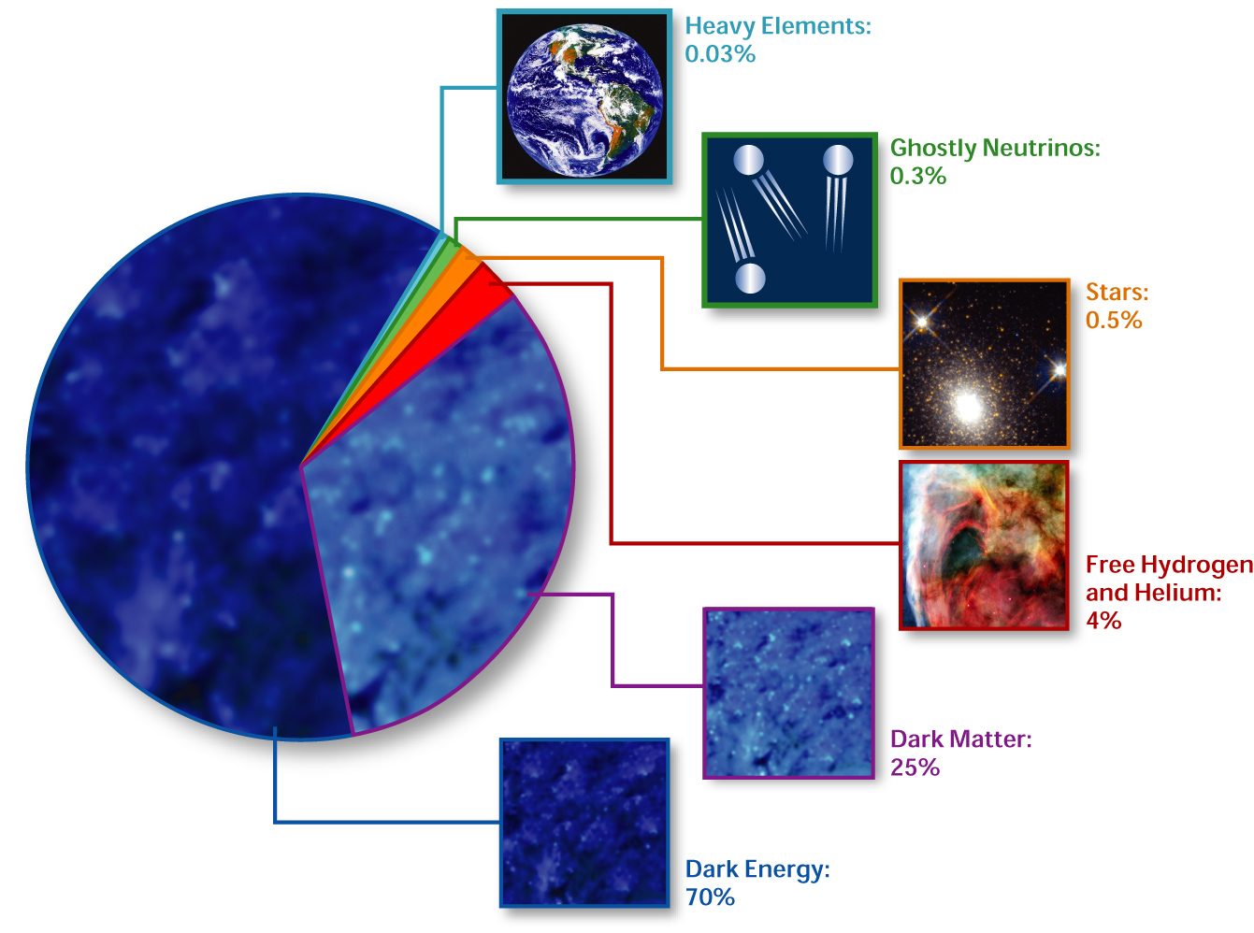
Standard Cosmological Model Composition of the Universe
Elcio Abdalla-Interacting Dark Energy
http://en.wikipedia.org/wiki/Image:Cosmological_composition.jpg source and rights]

Slide 14
The Dark Sector Structure

Slide 15
Precision Cosmology

Slide 16
Precision Cosmology

Slide 17
Precision Cosmology

Slide 18
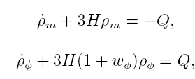
DE/DM Interaction
Each component is not conserved alone anymore.
Cosmological equations:
Many many models in the literature:
Phenomenological (For a classiﬁcation see Koyama, Maartens, Song, 0907.2126; see also Wang, Abdalla, Atrio Barandela, Pavon Rep. Prog. Phys. 2016)
- Interaction depending on DM or DE
Constant coupling
or
Time varying coupling
Coupling must be small : constraints from observations!
In general no analytic solution!

Slide 19
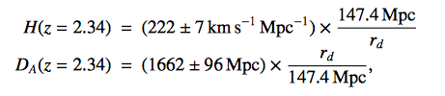
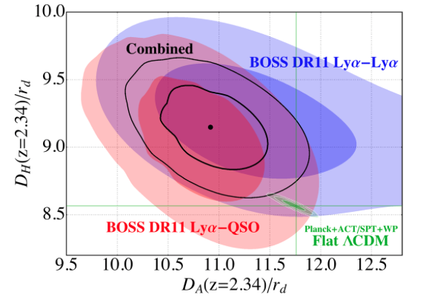
Evidence Against ΛDCM?
Baryon Acoustic Oscillations in the Lyα forest of BOSS DR11 quasars.
T. Delubac et al. [BOSS Collaboration] – A&A 574, A59 (2015), arXiv: 1404.1801
From adjusting the BAO peaks and combining with the ΛCDM fiducial values from Planck+ WMAP:
Values differ: 1.8σ from Planck+WP;
1.6σ from WMAP9+ACT+SPT
Constraints on (D_{A}/r_{d},D_{H}(=H/c)/r_{d})
Conclusion: Approximately 2σ below the value of D_{H}
And 2σ above the value of D_{A}
compared to the ΛCDM prediction.

Slide 20
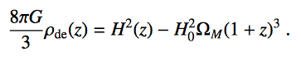
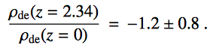
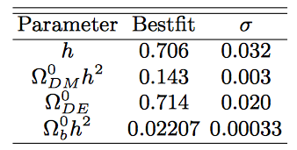
Evidence Against ΛDCM?
Baryon Acoustic Oscillations in the Lyα forest of BOSS DR11 quasars.
T. Delubac et al. [BOSS Collaboration] – A&A 574, A59 (2015), arXiv: 1404.1801
-
~2.5σ difference from the expected from ΛDCM!
Parameters from Planck+WMAP for ΛDCM
Interacting dark energy?
Review Rep. Progr. Phys.: Wang, E.A., Atrio-Barandela, Pavon

Slide 21
Whispers of the Universe: the BINGO project
The ABDUS Project

Slide 22
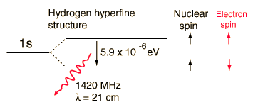
21 cm Physics – The Hyperfine Structure

Slide 23
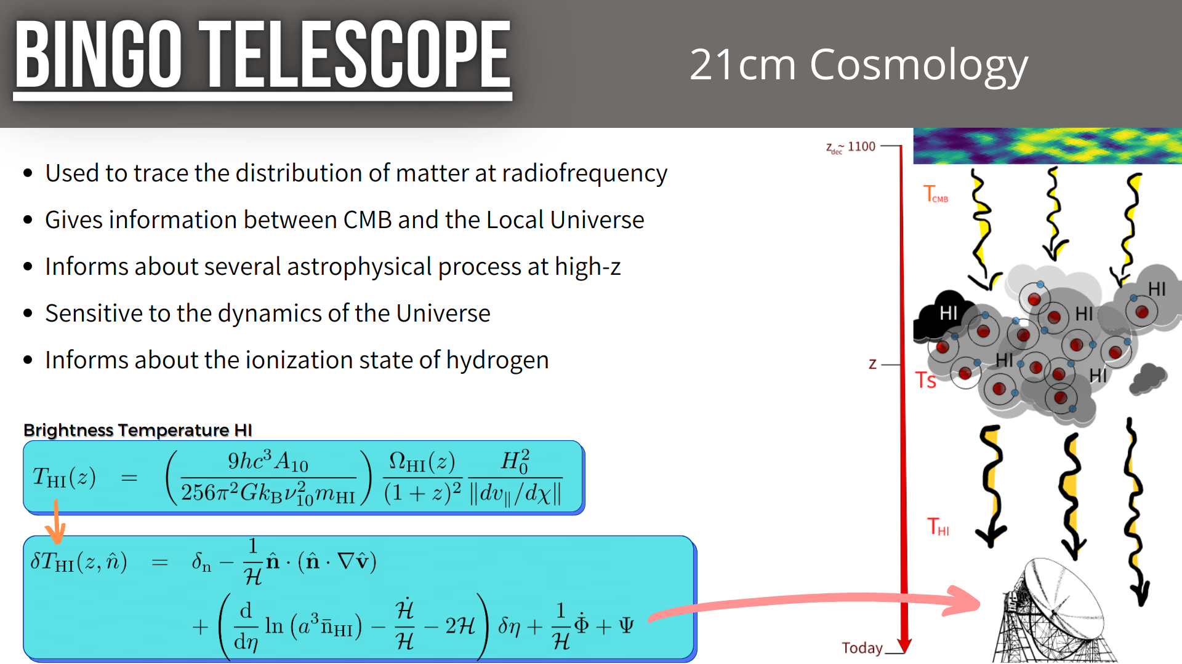
21 cm Cosmology: Motivation and Methods

Slide 24
Intensity Mapping
No Search for particular emission
Search instead for general Hydrogen emission
Large clouds

Slide 25
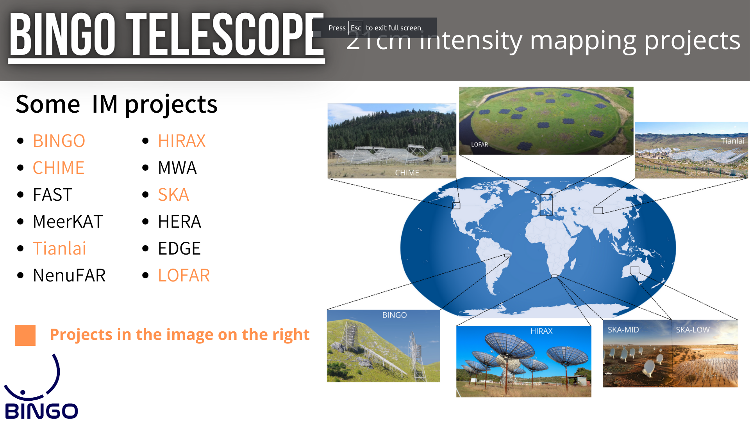

Slide 26
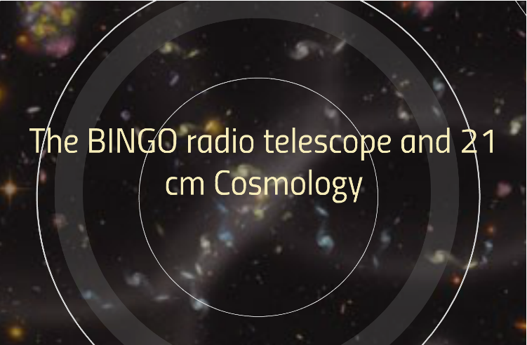

Slide 27
Bingo´s aims
BAO for Integrated Neutral Gas Observations
Large scale structure and constraints on Cosmological parameters (particularly DE)
HI intensity map at 0.127 < z < 0.448
Astrophysical phenomena: Fast Radio Bursts and Pulsars

Slide 28
What is Bingo?
BAO for Integrated Neutral Gas Observations
A single/double dish multiple Horns Radio Telescope, mainly to measure BAO
Short scale phenomena (we can pinpoint short lumps)

Slide 29
The Instrument
Two dishes (40 and 39 meters)
28 Horns (1.8 m wide, 4.8 m long)
System Temperature 50 K (up to now, we have 70K)
Simple off the shelf electronics in phase 1
Phased arrays in bingo 2
Site at “Serra do Urubu” (Vulture heights) in Paraíba, Brazil

Slide 30
The Site

Slide 31
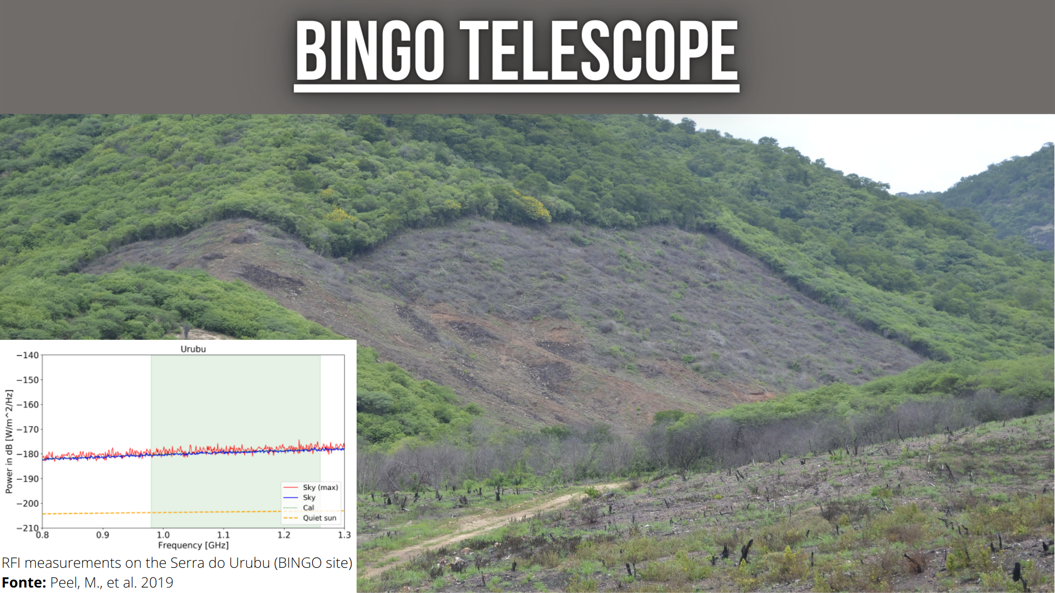
The Site
Clean sites in South America

Slide 32
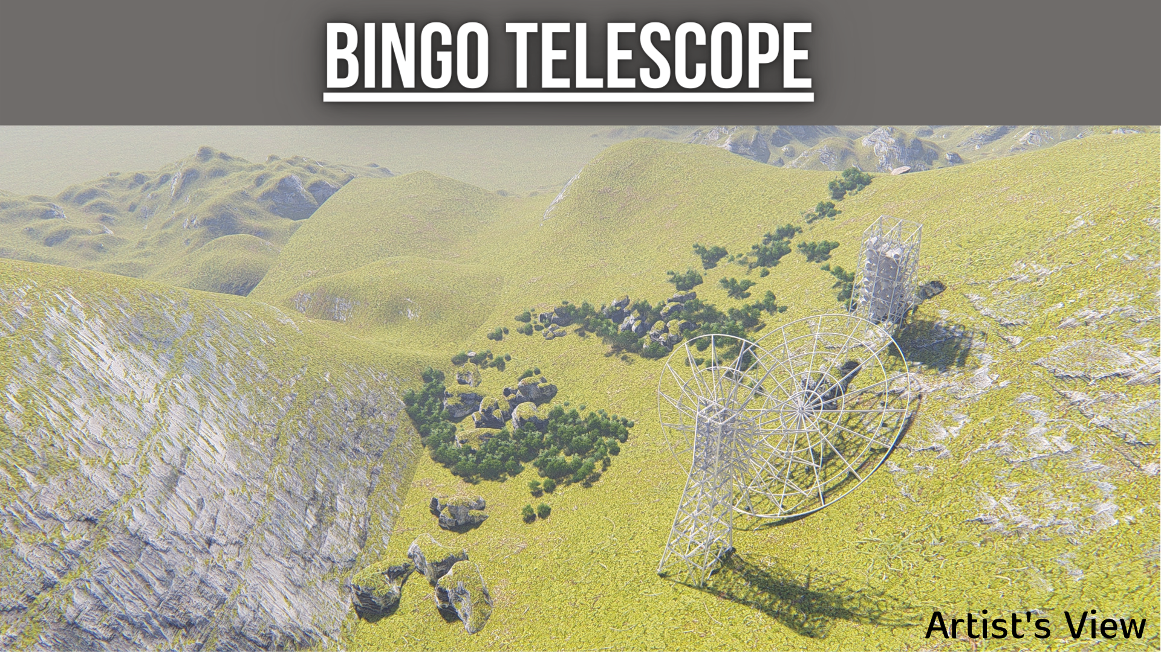

Slide 33
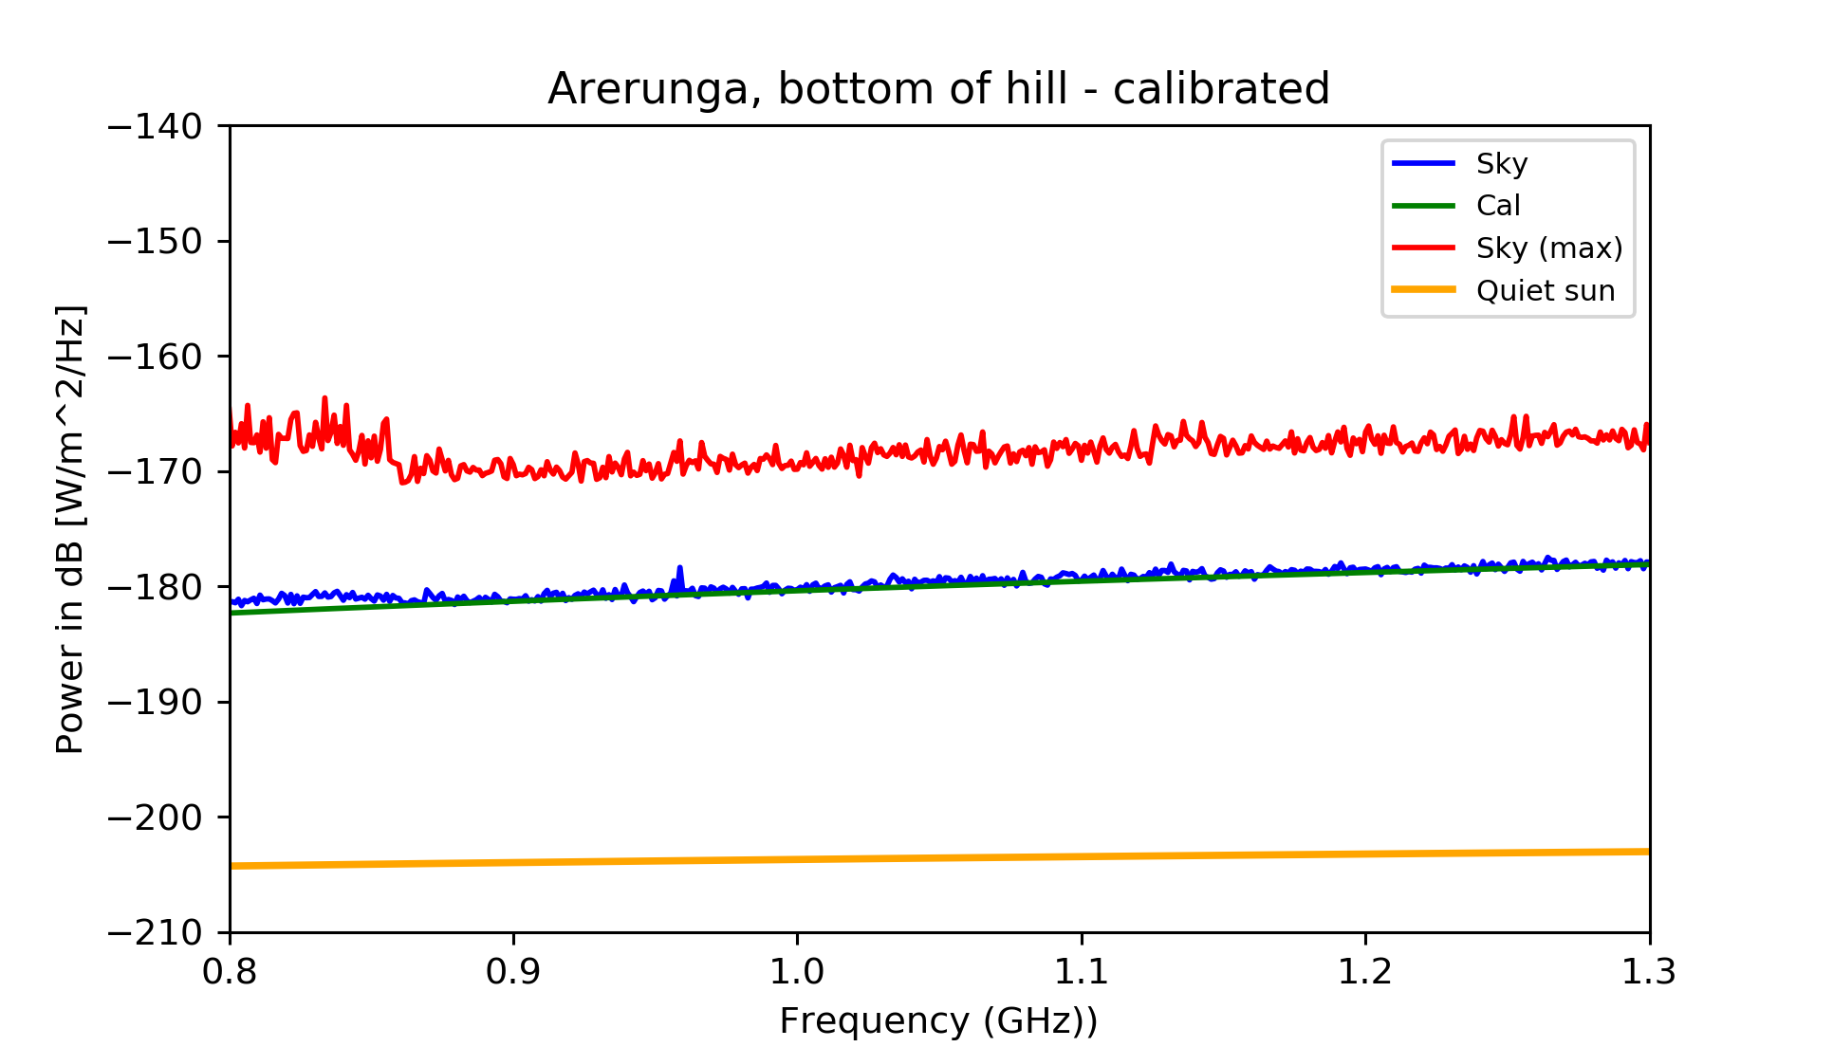
Uruguay

Slide 34
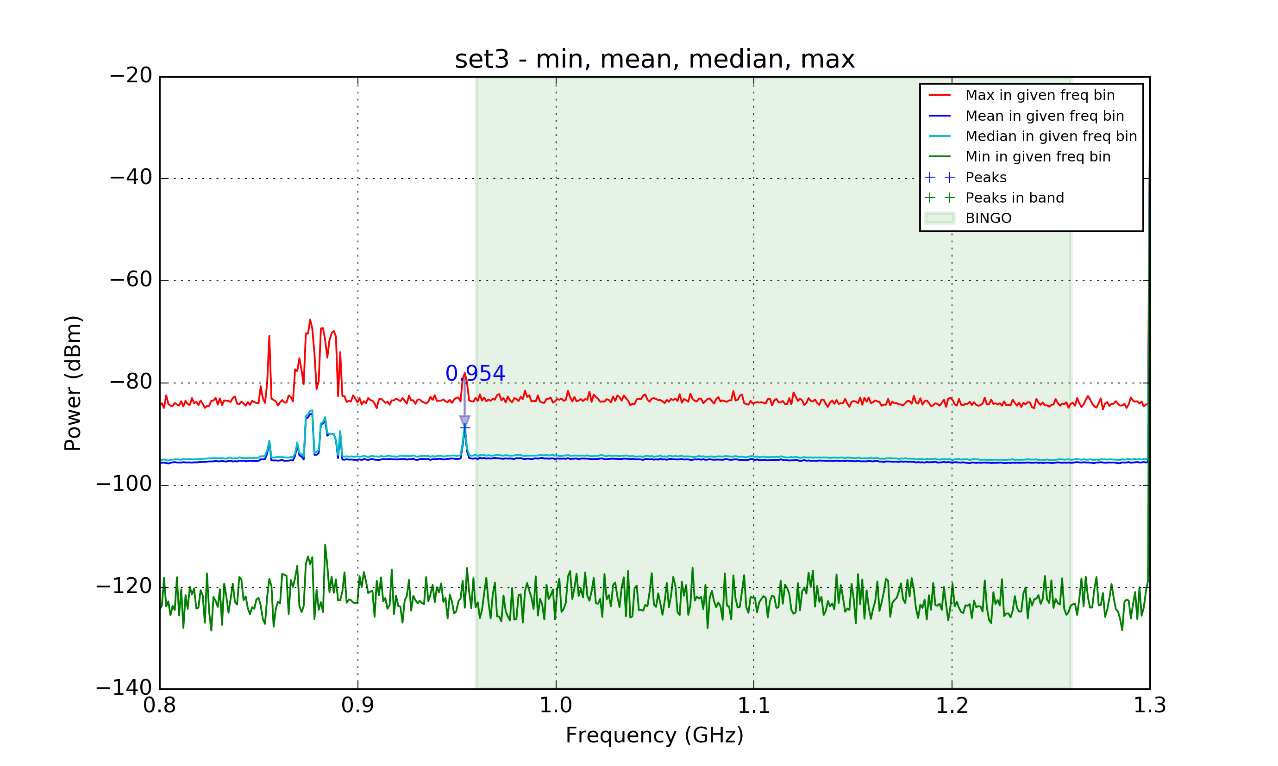
Cachoeira Paulista (SP)

Slide 35
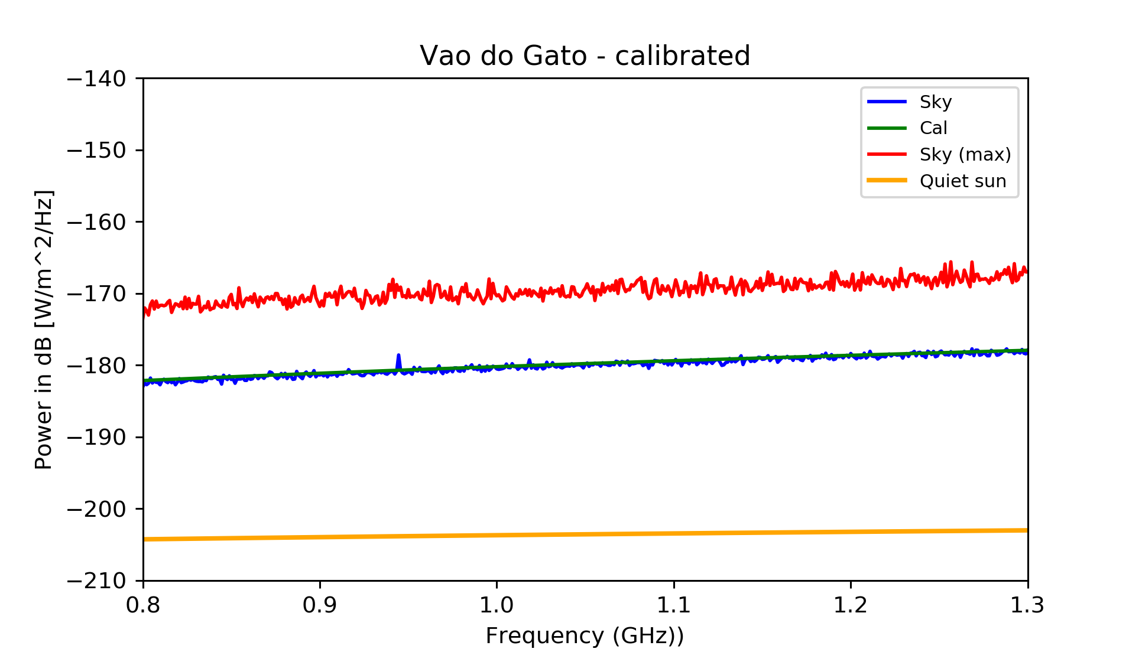
Vão do Gato (Cat’s den) Paraíba

Slide 36
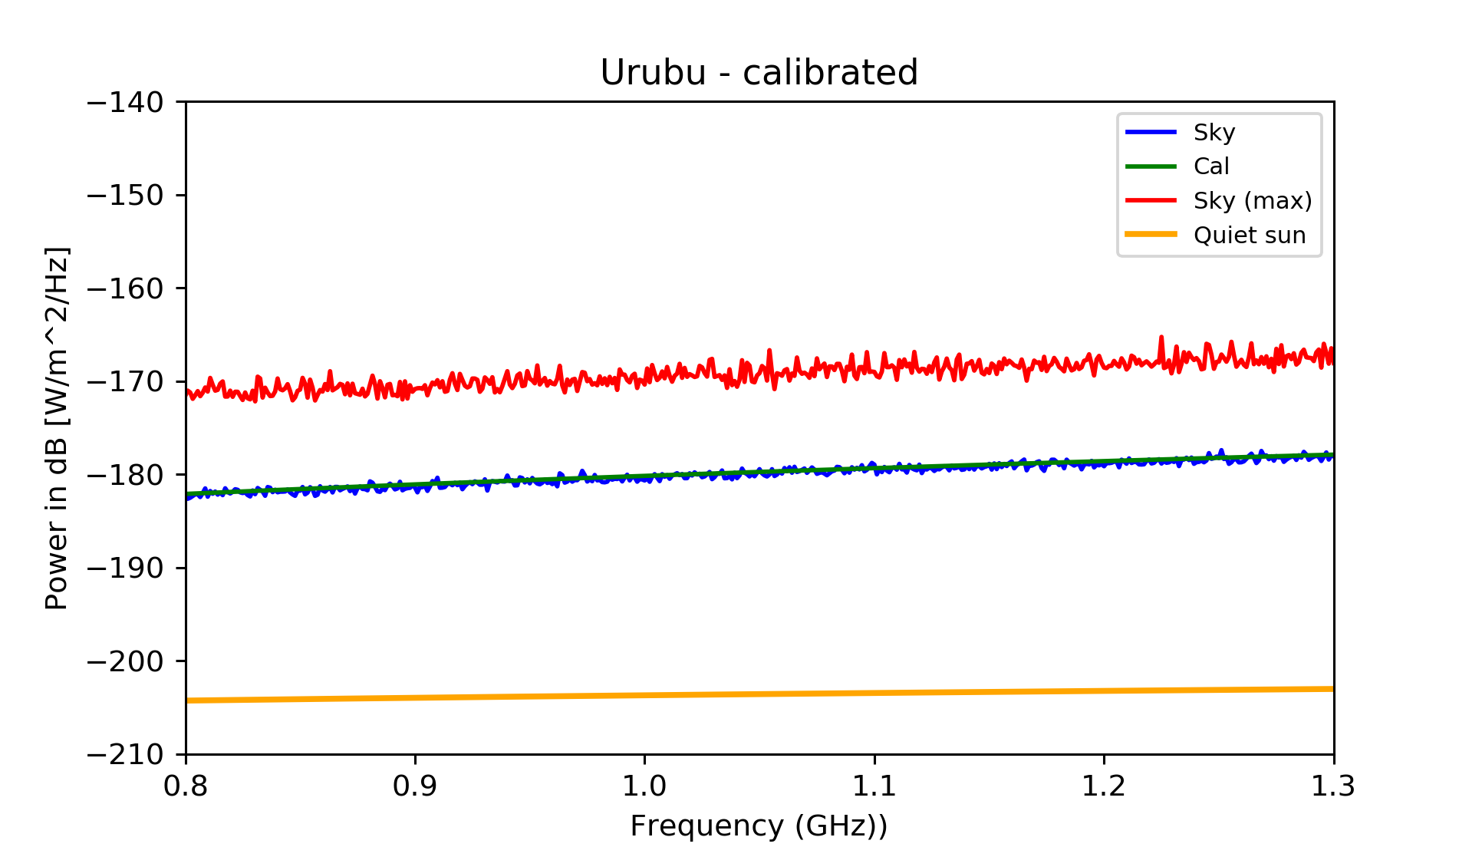
Urubu (Vulture heights), Paraíba

Slide 37
Motivations for BINGO
HI intensity mapping to measure BAO
Structure formation
Dark Sector properties (last half history of the Universe)
Static telescope, excellent for looking after transient phenomena
Fast astrophysical phenomena:
Pulsar properties
Fast Radio Bursts

Slide 38
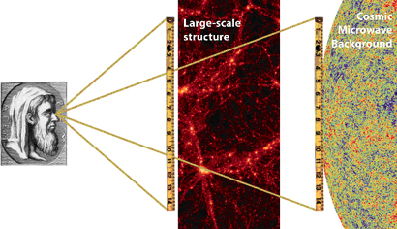
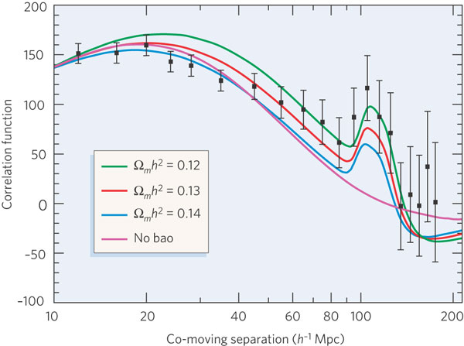
Baryon Acoustic Oscillations (BAOs)
Baryon oscillations seen in the CMB distribution can be observed in the spatial distribution of galaxies
Credit: EUCLID website (ESA)
The acoustic peak gives the ratio of the distances to z=.35 and z=1,100 to 4% fractional accuracy.
absolute distance to z=0.35 is determined to 5% accuracy.
co-moving sound horizon scale 150 h⁻¹ Mpc.
Credit: Bennett, Nature (2006)

Slide 39
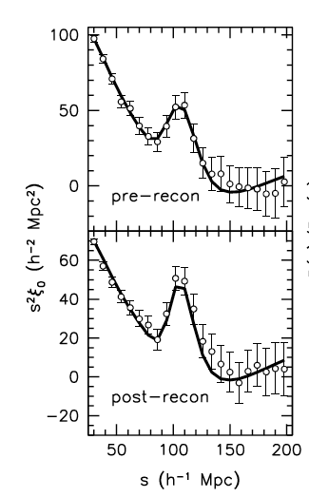
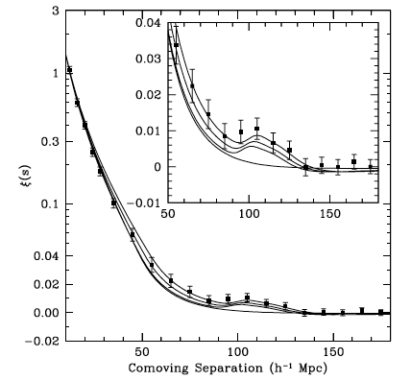
Optical BAOs
Anderson et al. (2014)
Eisenstein et al. (2005)
C.A. Wuensche (2016)
Notes:
The statistical sensitivity of the BAO measurement is limited by non-linear structure formation. Following Eisenstein et al. (2007a) we apply a procedure to reconstruct the linear density field. This procedure attempts to partially reverse the effects of non-linear growth of structure and large-scale peculiar velocities from the data. This is accomplished using the measured galaxy density field and Lagrangian theory relations between density and displacement. Reconstruction reduces the anisotropy in the clustering, reverses the smoothing of the BAO feature due to second-order effects, and significantly reduces the expected bias in the BAO distance scale that arises from these same second-order effects. Reconstruction thus improves the precision of our BAO scale measurements while simplifying our analyses.

Slide 40
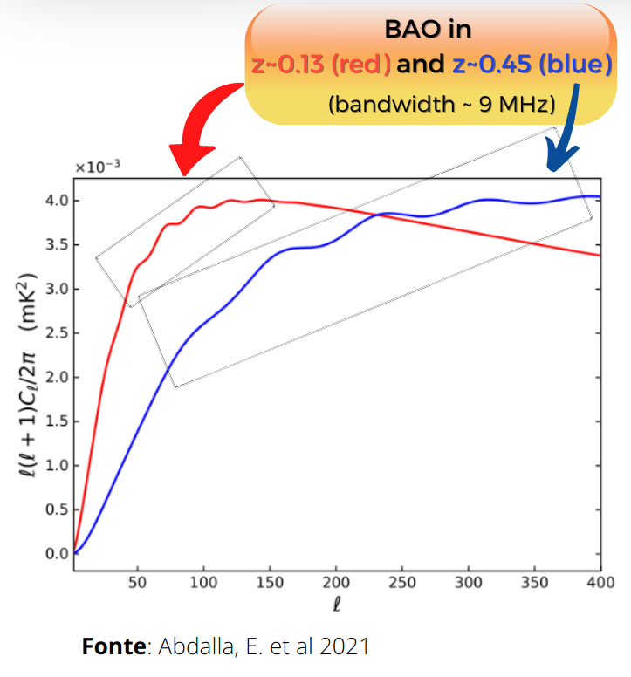
Baryon Acoustic Oscillations (BAOs)
Acoustic waves imprinted on CMB 380,000 years after Big Bang
Acoustic scale set by distance light travelled at that time
Known precisely from CMB power spectrum
D=149 ± 0.6 Mpc
BAO scale imprinted on all matter in the Universe
Use as a “standard ruler”
Credit: Chris Blake

Slide 41
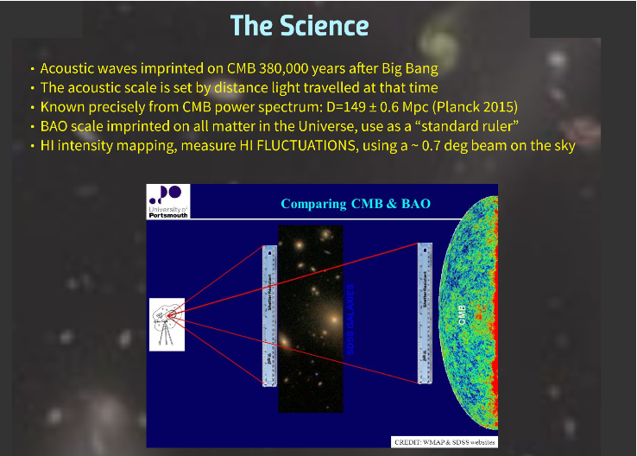

Slide 42
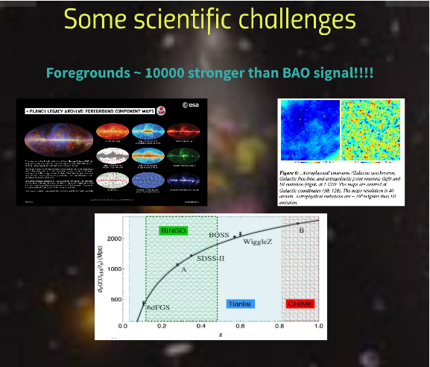

Slide 43
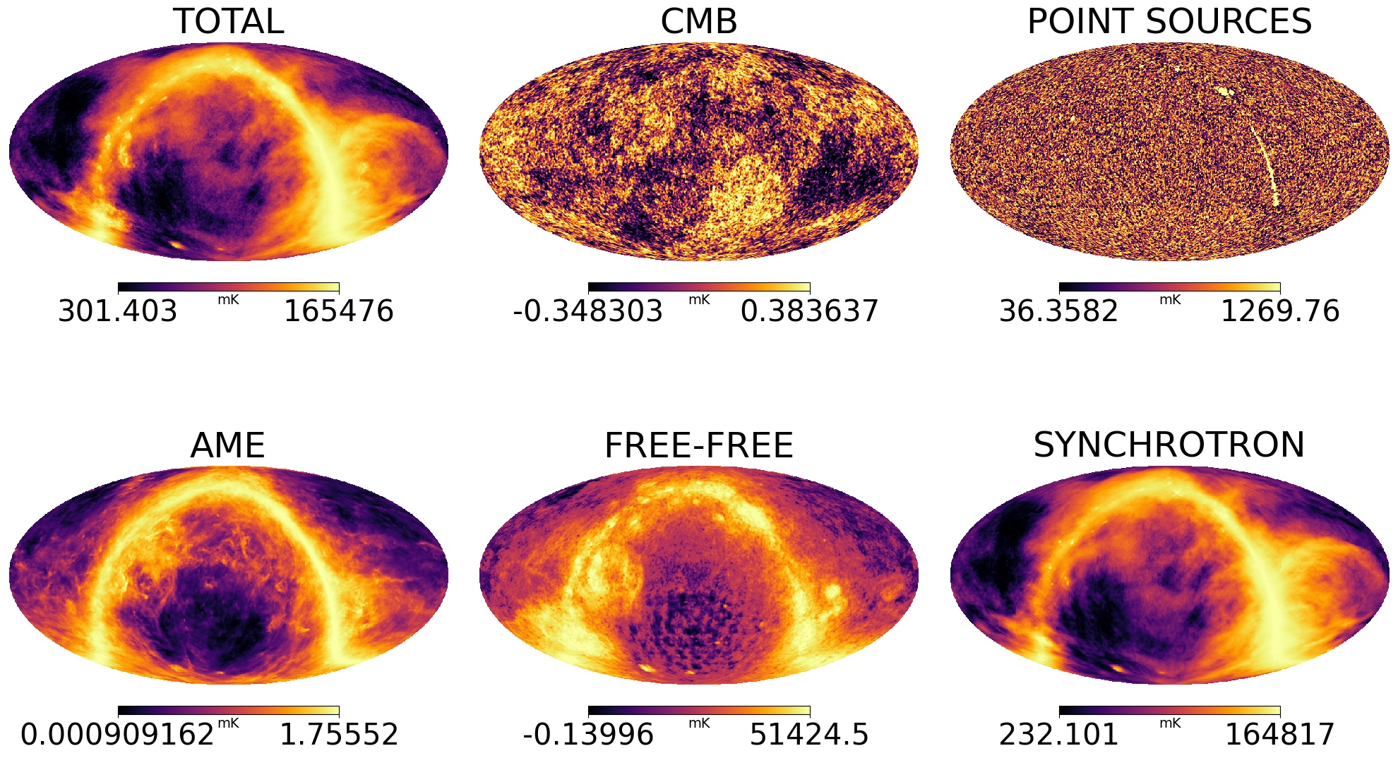

Slide 44
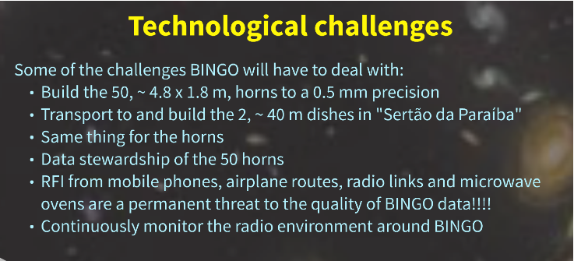

Slide 45
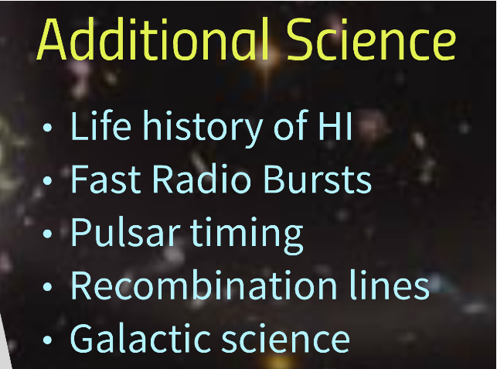

Slide 46
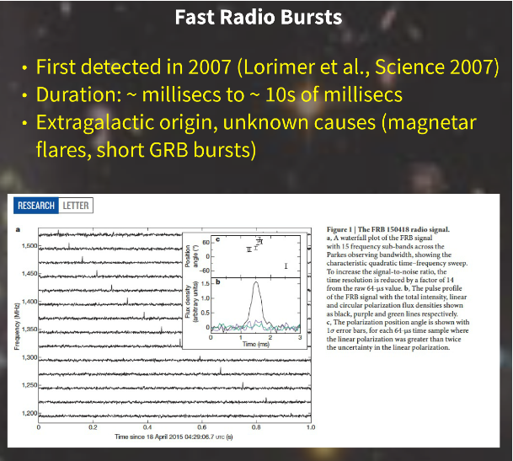

Slide 47
The various stages

Slide 48
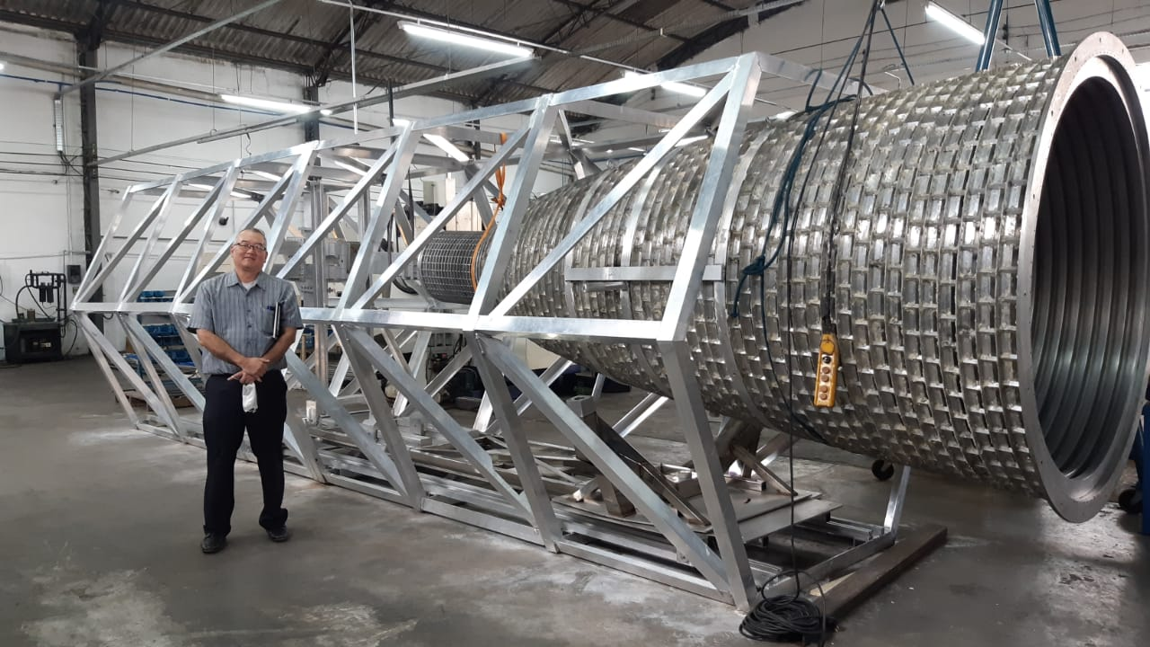
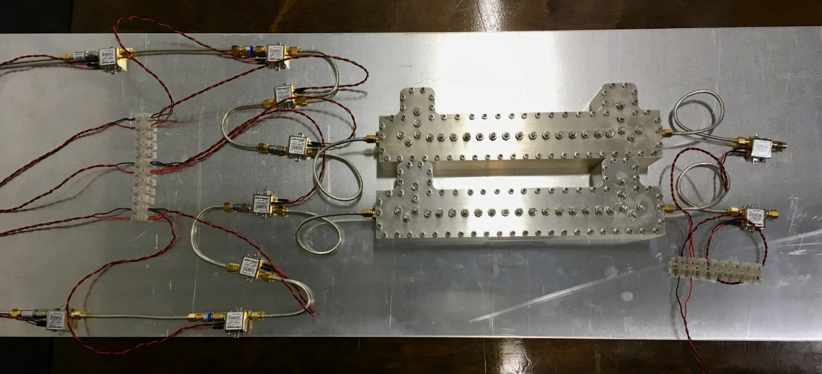
Stage 0
The Instrument:
Horns (basically done)
Receiver (already projected, now in series)

Slide 49
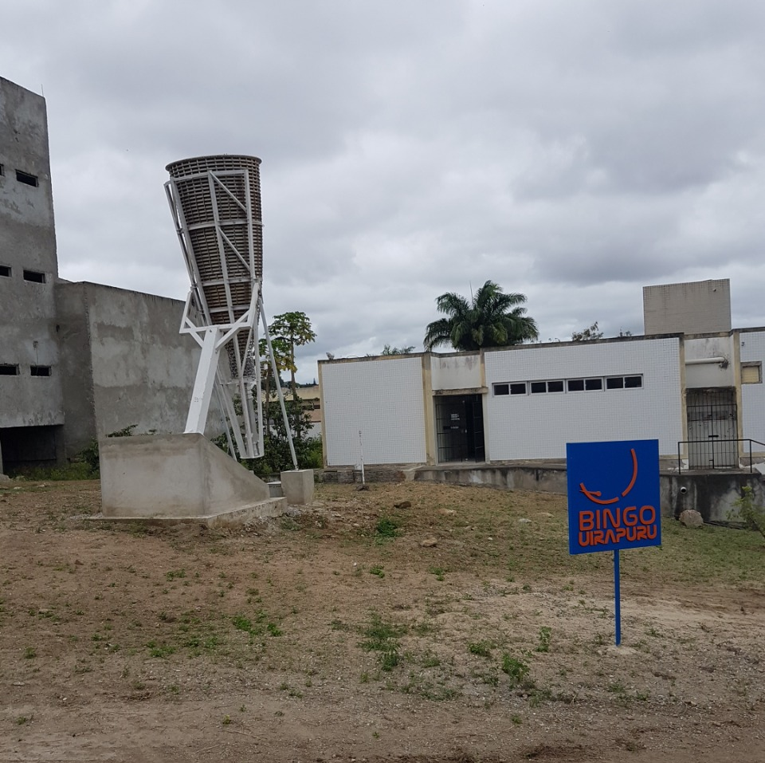
Stage 1
Raw data
FRB´s
Outriggers (Uiapuru in Campina Grande University campus, Paraiba)

Slide 50
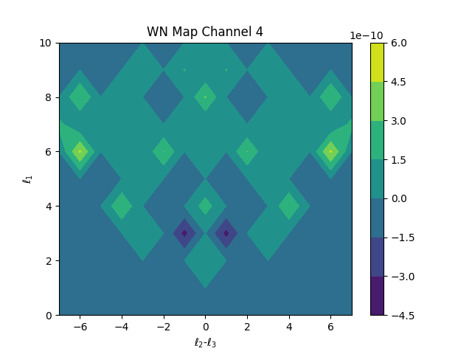
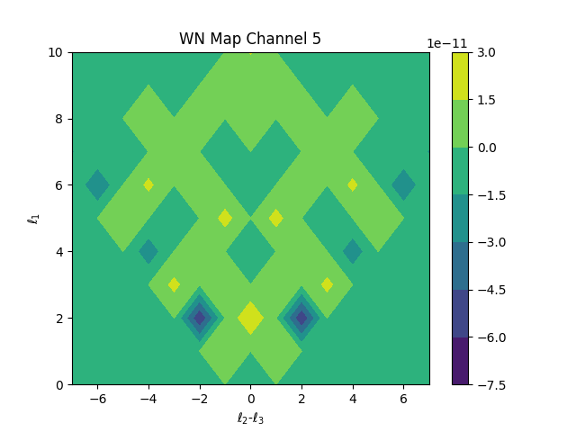
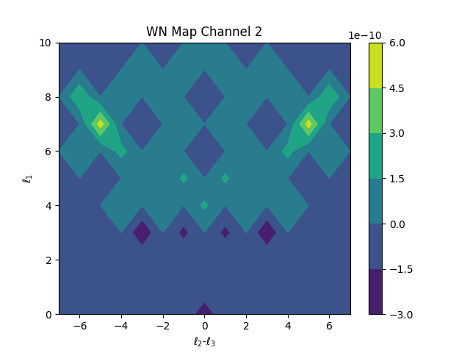
Stage 2
Component Separation
Noise analysis
Bispectrum

Slide 51
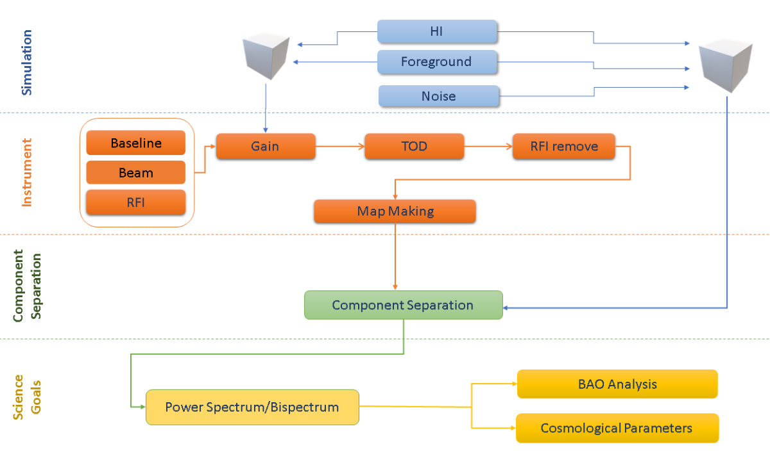
Stage 2
Component Separation: power spectrum, BAO, Cosmological Parameters

Slide 52
Stage 3
Mocks

Slide 53
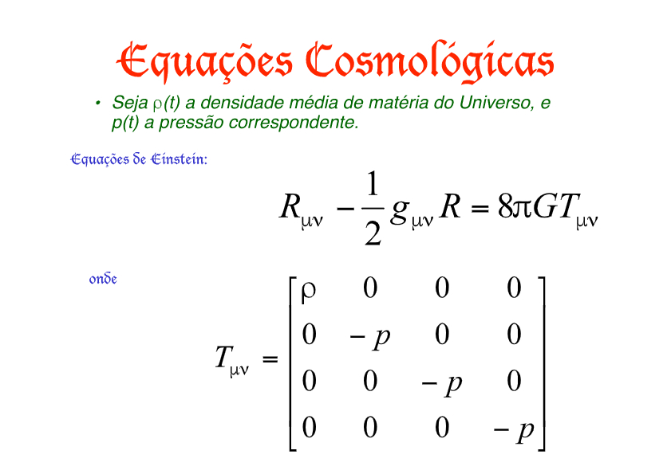
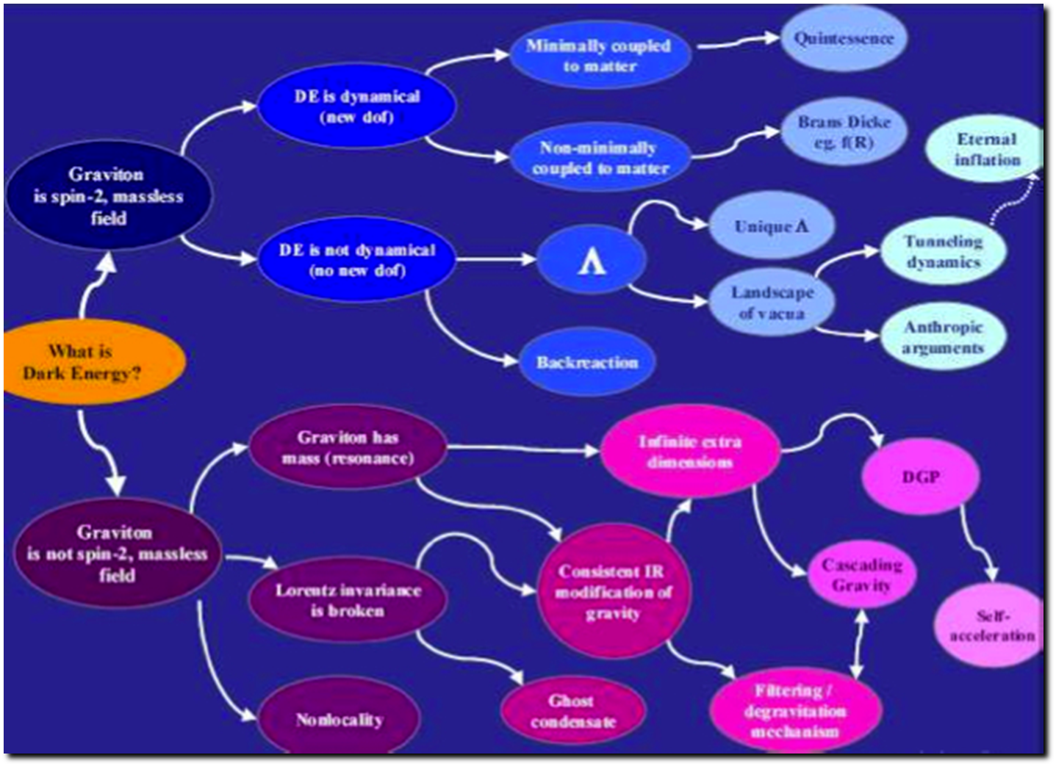
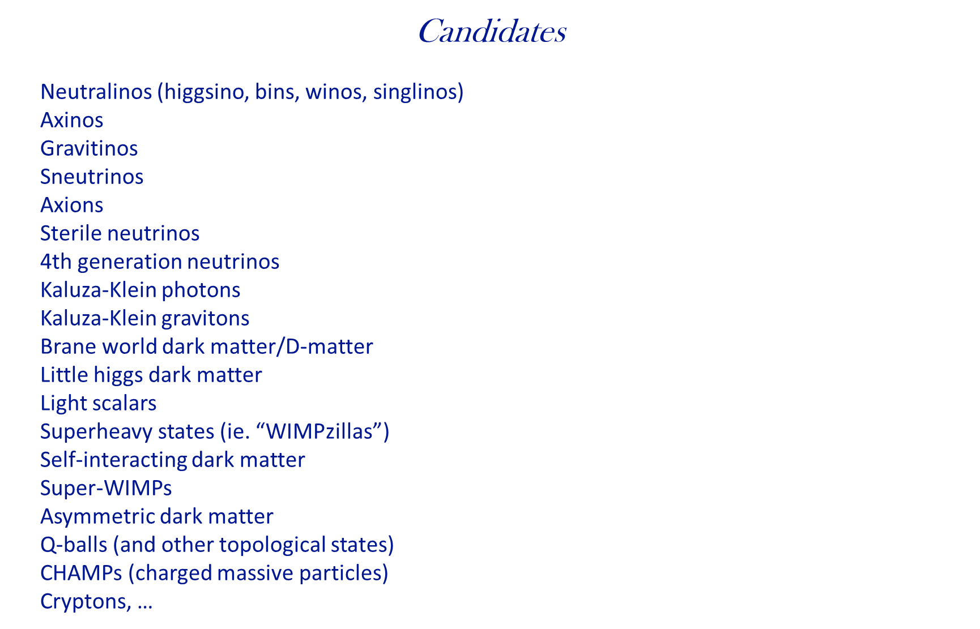
Stage 4
Theory

Slide 54
Theory
Structure of Dark Sector
cosmological parameters
DE/DM interactions
Models of DM/DE
FRB´s and cosmological parameters/consequences
Mass distribution
Pulsars
Flaring stars
Astrophysical signs and consequences
..............................

Slide 55




Construction
Ongoing construction operations

Slide 56



Outreach and education

Slide 57

Outreach and education
Work with local population and support from local Secretary of education from the Paraiba State

Slide 58







BINGO High Resolution the abdus project
Filipe Abdalla, Amilcar Queiroz, Elcio Abdalla, Bin Wang
450 – 1450 MHz
(z ~ 0 – 2.1)
1 MHz resolution
1.2 deg Resolution
T system 40K
Station 4500 m²
- What is the nature of dark energy?
- Can we measure the fluctuations with 21cm radiation
- Is our model of cosmology correct?

Slide 59

abdus forecasts
Can be competitive with even the largest surveys such as the Square Kilometre array.
Can also do other ancillary science extremely well such as finding the elusive FRBs.

Slide 60








BINGO
BAOs from Integrated Neutral Gas Observations

Slide 61



Slide 62
Support
FAPESP (Fundação de Amparo à Pesquisa do Estado de São Paulo)
Paraiba Government (João Azevedo, Claudio Furtado, Rubens Freire) *
FINEP (Projects and Studies financing – Federal Government)
Ministry of Science and Tecnology (Brazil)
Federal University of Campina Grande
University of São Paulo
National Natural Science Foundation of China
YangZhou University (China)
INPE (National Institute of Space Research, Brazil)

Slide 63




Main Collaborating Companies
Alltec (São Paulo): metallurgy/horns
CETC 54 (China): metal structure
IBRTEL (Paraiba): construction
Ponto de Apoio and GTP (projects)

Slide 64




Main Collaborating Companies
Alltec (São Paulo): metallurgy/horns
CETC 54 (China): metal structure
IBRTEL (Paraiba): construction
Ponto de Apoio and GTP (projects)

Slide 65
Inauguration and begining of commissioning
Between September and November 2024

Slide 66
Visit our sites
https://portal.if.usp.br/bingotelescope/
http://www.bingotelescope.org/en/
https://pt.wikipedia.org/wiki/BINGO_(telescópio)
https://www.facebook.com/BINGOTelescopio/

